Slide 1

Q1
Quarterly Market Review
First Quarter 2026
135202

Slide 2
Quarterly Market Review
This report features world capital market performance and a timeline of events for the past quarter. It begins with a global overview, then features the returns of stock and bond asset classes in the US and international markets. The report concludes with a quarterly topic.
Overview:
Market Summary
World Stock Market Performance
US Stocks
International Developed Stocks
Emerging Markets Stocks
Country Returns
Real Estate Investment Trusts (REITs)
Commodities
Fixed Income
Global Fixed Income
Quarterly Topic: Geopolitical Risk
135210

Slide 3
Quarterly Market Summary
Returns (USD), as of March 31, 2026
 | Stocks |  |  |  | Bonds
 | US Stock Market | International Developed Stocks | Emerging Markets Stocks | Global Real Estate | US Bond Market | Global Bond Market ex US
Q1 2026 | -3.96% | -0.94% | -0.17% | 0.77% | -0.05% | -0.19%
Since January 2000
Average Quarterly Return | 2.3% | 1.6% | 2.2% | 2.2% | 1.0% | 1.0%
Best Quarter | 22.0% | 25.9% | 34.7% | 32.3% | 6.8% | 5.4%
15 Years | 2020 Q2 | 2009 Q2 | 2009 Q2 | 2009 Q3 | 2023 Q4 | 2023 Q4
Worst Quarter | -22.8% | -23.3% | -27.6% | -36.1% | -5.9% | -4.1%
20 Years | 2008 Q4 | 2020 Q1 | 2008 Q4 | 2008 Q4 | 2022 Q1 | 2022 Q1
Past performance is not a guarantee of future results. Indices are not available for direct investment. Index performance does not reflect the expenses associated with the management of an actual portfolio.
Market segment (index representation) as follows: US Stock Market (Russell 3000 Index), International Developed Stocks (MSCI World ex USA Index [net dividends]), Emerging Markets (MSCI Emerging Markets Index [net dividends]), Global Real Estate (S&P Global REIT Index [net dividends]), US Bond Market (Bloomberg US Aggregate Bond Index), and Global Bond Market ex US (Bloomberg Global Aggregate ex-USD Bond Index [hedged to USD]). S&P data © 2026 S&P Dow Jones Indices LLC, a division of S&P Global. All rights reserved. Frank Russell Company is the source and owner of the trademarks, service marks, and copyrights related to the Russell Indexes. MSCI data © MSCI 2026, all rights reserved. Bloomberg data provided by Bloomberg.
135211

Slide 4
Long-Term Market Summary
Returns (USD), as of March 31, 2026
 | Stocks |  |  |  | Bonds
 | US Stock Market | International Developed Stocks | Emerging Markets Stocks | Global Real Estate | US Bond Market | Global Bond Market ex US
1 Year | 18.09% | 22.99% | 29.55% | 7.03% | 4.35% | 2.77%
5 Years | 10.87% | 8.40% | 3.69% | 2.83% | 0.31% | 1.13%
10 Years | 13.72% | 8.66% | 7.80% | 3.17% | 1.70% | 2.20%
15 Years | 12.81% | 6.26% | 3.67% | 5.08% | 2.39% | 3.18%
20 Years | 10.26% | 5.17% | 5.38% | 3.75% | 3.28% | 3.43%
Past performance is not a guarantee of future results. Indices are not available for direct investment. Index performance does not reflect the expenses associated with the management of an actual portfolio.
Market segment (index representation) as follows: US Stock Market (Russell 3000 Index), International Developed Stocks (MSCI World ex USA Index [net dividends]), Emerging Markets (MSCI Emerging Markets Index [net dividends]), Global Real Estate (S&P Global REIT Index [net dividends]), US Bond Market (Bloomberg US Aggregate Bond Index), and Global Bond Market ex US (Bloomberg Global Aggregate ex-USD Bond Index [hedged to USD]). S&P data © 2026 S&P Dow Jones Indices LLC, a division of S&P Global. All rights reserved. Frank Russell Company is the source and owner of the trademarks, service marks, and copyrights related to the Russell Indexes. MSCI data © MSCI 2026, all rights reserved. Bloomberg data provided by Bloomberg.
135212

Slide 5
World Stock Market Performance
MSCI All Country World Index with selected headlines from Q1 2026
1 year (q2 2025–Q1 2026)
Q1 2026
JANUARY | FEBRUARY | MARCH
01/06 “Dow Extends Rally, Closing Above 49000 for First Time” 01/08 “Trump Calls on Fannie and Freddie to Buy $200 Billion in Mortgage Bonds” 01/20 “Tensions Over Greenland Rattle Wall Street” 01/21 “Private-Credit Investors Are Cashing Out in Droves” 01/26 “Gold Surges Above $5,000 on Shutdown Fears, Geopolitical Tensions” 01/28 “Fed Holds Rates Steady for First Time Since July” 01/28 “S&P 500 Crosses 7000 for First Time” | 02/03 “House Approves Measure to End Partial Government Shutdown” 02/11 “US Added 130,000 Jobs in January, Starting Year Off on Stronger Footing” 02/12 “Homes Sales in January Post Biggest Monthly Decline in Nearly Four Years” 02/20 “Supreme Court Strikes Down Trump’s Global Tariffs” 02/26 “Mortgage Rates Fall Below 6% for the First Time Since 2022” 02/28 “US and Israel Attack Iran” | 03/06 “US Lost 92,000 Jobs in February in Unexpected Downturn” 03/08 “Oil Tops $100 a Barrel for First Time Since 2022” 03/11 “IEA Will Launch Largest-Ever Oil Release From Global Strategic Reserves” 03/18 “Fed Holds Steady and Maintains Rate-Cut Projection” 03/27 “Market Dive Points to Wall Street’s Growing Alarm Over Iran War” 03/31 “US Gas Prices Top $4 a Gallon” 03/31 “Nasdaq Leads Rally Built on Hope the Iran War May End Soon”
These headlines are not offered to explain market returns. Instead, they serve as a reminder that investors should view daily events from a long-term perspective and avoid making investment decisions based solely on the news.
Graph Source: MSCI ACWI Index (net dividends). MSCI data © MSCI 2026, all rights reserved. Index level based at 100 starting January 2000. It is not possible to invest directly in an index. Performance does not reflect the expenses associated with management of an actual portfolio. Past performance is not a guarantee of future results.
135213

Slide 6
World Stock Market Performance
MSCI All Country World Index with selected headlines from past 12 months
Long Term (2000–Q1 2026)
Short Term (Q2 2025–Q1 2026)
Q2 2025 | Q3 2025 | Q4 2025 | Q1 2026
04/02 “Trump Unveils Sweeping Tariffs in Stark Shift in US Trade Policy” 04/09 “Stocks Stage Furious Rally as Trump Pauses Some Tariffs” 05/12 “Stocks Soar on Temporary US-China Tariff Rollback” 05/16 “US Loses Last Triple-A Credit Rating” 06/22 “Massive US Strikes Target Iranian Nuclear Sites” 06/27 “Historic Rebound Sends S&P 500 to New Highs” | 07/03 “President Trump’s Megabill Passes House Vote” 07/27 “Trump and EU Reach Tariff Deal, Avoiding Trade War” 08/16 “Trump-Putin Summit Ends Without Breakthrough” 09/17 “Fed Cuts Rates by Quarter Point and Signals More Are Likely” 09/22 “A Deal Between AI Powers Lifts Stock Market to a Record” | 10/01 “Government Shutdown Begins as Funding Lapses” 11/07 “Nasdaq Has Its Worst Week Since April” 11/13 “Trump Signs Spending Bill, Ending Longest Shutdown in US History” 12/10 “Fed Cuts Rates Again, Signals It May Be Done for Now” 12/31 “Stock Markets Close Out a Record-Setting Year” | 01/20 “Tensions Over Greenland Rattle Wall Street” 01/28 “Fed Holds Rates Steady for First Time Since July” 02/20 “Supreme Court Strikes Down Trump’s Global Tariffs” 02/28 “US and Israel Attack Iran” 03/08 “Oil Tops $100 a Barrel for First Time Since 2022” 03/18 “Fed Holds Steady and Maintains Rate-Cut Projection” 03/31 “Nasdaq Leads Rally Built on Hope the Iran War May End Soon”
“"President Trump’s Megabill Passes House Vote"”
These headlines are not offered to explain market returns. Instead, they serve as a reminder that investors should view daily events from a long-term perspective and avoid making investment decisions based solely on the news.
Graph Source: MSCI ACWI Index (net dividends). MSCI data © MSCI 2026, all rights reserved. Index level based at 100 starting January 2000. It is not possible to invest directly in an index. Performance does not reflect the expenses associated with management of an actual portfolio. Past performance is not a guarantee of future results.
135214

Slide 7
US Stocks
Returns (USD), 1st Quarter 2026
The US equity market posted negative returns for the quarter and underperformed both non-US developed and emerging markets.
Value outperformed growth.
Small caps outperformed large caps.
REIT indices outperformed equity market indices.
Ranked Returns (%)
Small Value
Large Value
Small Cap
Small Growth
Marketwide
Large Cap
Large Growth
World Market Capitalization
Periodic Returns (%)
 |  | ANNUALIZED | ANNUALIZED | * Annualized
Asset Class | QTR | 1 Year | 3 Years | 5 Years | 10 Years | 15 Years | 20 Years
Small Value | 4.96 | 28.09 | 13.80 | 5.79 | 9.61 | 8.62 | 6.98
Large Value | 2.10 | 15.87 | 14.31 | 9.43 | 10.58 | 10.47 | 8.12
Small Cap | 0.89 | 25.72 | 13.05 | 3.77 | 9.88 | 8.98 | 7.54
Small Growth | -2.81 | 23.58 | 12.27 | 1.62 | 9.79 | 9.09 | 7.88
Marketwide | -3.96 | 18.09 | 17.86 | 10.87 | 13.72 | 12.81 | 10.26
Large Cap | -4.18 | 17.74 | 18.14 | 11.34 | 13.97 | 13.09 | 10.46
Large Growth | -9.78 | 18.81 | 21.18 | 12.76 | 16.83 | 15.33 | 12.48
US Market
$62.6 trillion
Past performance is not a guarantee of future results. Indices are not available for direct investment. Index performance does not reflect the expenses associated with the management of an actual portfolio. Market segment (index representation) as follows: Marketwide (Russell 3000 Index), Large Cap (Russell 1000 Index), Large Value (Russell 1000 Value Index), Large Growth (Russell 1000 Growth Index), Small Cap (Russell 2000 Index), Small Value (Russell 2000 Value Index), and Small Growth (Russell 2000 Growth Index). World Market Cap represented by Russell 3000 Index, MSCI World ex USA IMI Index, and MSCI Emerging Markets IMI Index. Russell 3000 Index is used as the proxy for the US market. Dow Jones US Select REIT Index used as proxy for the US REIT market. MSCI data © MSCI 2026, all rights reserved. Frank Russell Company is the source and owner of the trademarks, service marks, and copyrights related to the Russell Indexes.
135215

Slide 8
International Developed Stocks
Firm Logo
Returns (USD), 1st Quarter 2026
Developed markets outside of the US posted negative returns for the quarter and outperformed US markets, but underperformed emerging markets.
Value outperformed growth.
Small caps outperformed large caps.
Ranked Returns (%)
Value
Small Cap
Marketwide
Large Cap
Growth
Value
Large Cap
Growth
World Market Capitalization
Periodic Returns (%)
Small Cap
 |  | ANNUALIZED | ANNUALIZED | * Annualized
Asset Class | QTR | 1 Year | 3 Years | 5 Years | 10 Years | 15 Years | 20 Years
Value | 2.50 | 32.19 | 20.37 | 12.69 | 9.71 | 6.50 | 5.14
Small Cap | -0.37 | 29.19 | 13.77 | 5.40 | 7.95 | 6.56 | 5.49
Marketwide | -0.86 | 23.84 | 14.23 | 7.96 | 8.56 | 6.29 | 5.25
Large Cap | -0.94 | 22.99 | 14.30 | 8.40 | 8.66 | 6.26 | 5.17
Growth | -4.60 | 13.95 | 8.34 | 3.99 | 7.31 | 5.79 | 5.01
International Developed Markets
$26.6 trillion
Past performance is not a guarantee of future results. Indices are not available for direct investment. Index performance does not reflect the expenses associated with the management of an actual portfolio. Market segment (index representation) as follows: Marketwide (MSCI World ex USA IMI Index), Large Cap (MSCI World ex USA Index), Small Cap (MSCI World ex USA Small Cap Index), Value (MSCI World ex USA Value Index), and Growth (MSCI World ex USA Growth Index). All index returns are net of withholding tax on dividends. World Market Cap represented by Russell 3000 Index, MSCI World ex USA IMI Index, and MSCI Emerging Markets IMI Index. MSCI World ex USA IMI Index is used as the proxy for the International Developed market. MSCI data © MSCI 2026, all rights reserved. Frank Russell Company is the source and owner of the trademarks, service marks, and copyrights related to the Russell Indexes.
135216

Slide 9
Emerging Markets Stocks
Returns (USD), 1st Quarter 2026
Emerging Markets posted negative returns for the quarter and outperformed both US and non-US developed markets.
Value outperformed growth.
Small caps underperformed large caps.
Ranked Returns (%)
Value
Large Cap
Marketwide
Small Cap
Growth
World Market Capitalization
Periodic Returns (%)
 |  | ANNUALIZED | ANNUALIZED | * Annualized
Asset Class | QTR | 1 Year | 3 Years | 5 Years | 10 Years | 15 Years | 20 Years
Value | 1.10 | 28.65 | 15.52 | 6.14 | 7.27 | 2.70 | 5.10
Large Cap | -0.17 | 29.55 | 14.84 | 3.69 | 7.80 | 3.67 | 5.38
Marketwide | -0.24 | 28.88 | 14.67 | 4.03 | 7.82 | 3.75 | 5.55
Small Cap | -0.74 | 24.55 | 13.74 | 6.68 | 8.13 | 4.44 | 6.59
Growth | -1.43 | 30.21 | 14.11 | 1.36 | 8.22 | 4.53 | 5.57
Emerging Markets
$11.7 trillion
Past performance is not a guarantee of future results. Indices are not available for direct investment. Index performance does not reflect the expenses associated with the management of an actual portfolio. Market segment (index representation) as follows: Marketwide (MSCI Emerging Markets IMI Index), Large Cap (MSCI Emerging Markets Index), Small Cap (MSCI Emerging Markets Small Cap Index), Value (MSCI Emerging Markets Value Index), and Growth (MSCI Emerging Markets Growth Index). All index returns are net of withholding tax on dividends. World Market Cap represented by Russell 3000 Index, MSCI World ex USA IMI Index, and MSCI Emerging Markets IMI Index. MSCI Emerging Markets IMI Index used as the proxy for the emerging market portion of the market. MSCI data © MSCI 2026, all rights reserved. Frank Russell Company is the source and owner of the trademarks, service marks, and copyrights related to the Russell Indexes.
135217

Slide 10
Country Returns
Returns (USD), 1st Quarter 2026
Global
Past performance is no guarantee of future results.
Country returns are the country component indices of the MSCI All Country World IMI Index for all countries except the United States, where the Russell 3000 Index is used instead. Global is the return of the MSCI All Country World IMI Index. MSCI index returns are net dividend. Indices are not available for direct investment. Their performance does not reflect the expenses associated with the management of an actual portfolio. Frank Russell Company is the source and owner of the trademarks, service marks and copyrights related to the Russell Indexes. MSCI data © MSCI 2026, all rights reserved.
135203

Slide 11
Real Estate Investment Trusts (REITs)
Returns (USD), 1st Quarter 2026
US real estate investment trusts outperformed non-US REITs during the quarter.
Ranked Returns (%)
US REITS
Global ex US REITS
Total Value of REIT Stocks
Periodic Returns (%)
 |  | ANNUALIZED | ANNUALIZED | * Annualized
Asset Class | QTR | 1 Year | 3 Years | 5 Years | 10 Years | 15 Years | 20 Years
US REITS | 4.64 | 7.23 | 9.15 | 5.59 | 4.76 | 7.12 | 5.46
Global ex US REITS | -7.88 | 10.68 | 3.99 | -0.99 | 0.95 | 2.79 | 2.21
US
$1,107 billion 100 REITs
70% US
30% Global ex US
Global ex US
$467 billion 277 REITs (26 other countries)
Past performance is not a guarantee of future results. Indices are not available for direct investment. Index performance does not reflect the expenses associated with the management of an actual portfolio. Number of REIT stocks and total value based on the two indices. All index returns are net of withholding tax on dividends. Total value of REIT stocks represented by Dow Jones US Select REIT Index and the S&P Global ex US REIT Index. Dow Jones US Select REIT Index used as proxy for the US market, and S&P Global ex US REIT Index used as proxy for the World ex US market. Dow Jones and S&P data © 2026 S&P Dow Jones Indices LLC, a division of S&P Global. All rights reserved.
135204

Slide 12
Commodities
Returns (USD), 1st Quarter 2026
The Bloomberg Commodity Total Return Index returned +24.41% for the first quarter of 2026.
Low Sulphur Gas Oil and Heating Oil were the best performers, returning +108.53% and +106.43% for the quarter, respectively. Coffee and Lead were the worst performers, returning -12.44% and -6.98% for the quarter, respectively.
Commodities Ranked Returns (%)
Commodities Periodic Returns (%)
 | ANNUALIZED | ANNUALIZED | Annualized
QTR | 1 Year | 3 Years | 5 Years | 10 Years | 15 Years | 20 Years
24.41 | 32.29 | 13.88 | 14.04 | 8.02 | 0.06 | 0.68
Past performance is not a guarantee of future results. Index is not available for direct investment. Index performance does not reflect the expenses associated with the management of an actual portfolio. Commodities returns represent the return of the Bloomberg Commodity Total Return Index. Individual commodities are sub-index values of the Bloomberg Commodity Total Return Index. Data provided by Bloomberg.
135205

Slide 13
Fixed Income
Returns (USD), 1st Quarter 2026
Within the US Treasury market, interest rates increased during the quarter.
On the short end of the yield curve, the 1-Month US Treasury Bill yield remained unchanged at 3.74%. The 1-Year US Treasury Bill yield increased 20 basis points (bps) to 3.68%. The yield on the 2-Year US Treasury Note increased 32 bps to 3.79%.
The yield on the 5-Year US Treasury Note increased 19 bps to 3.92%. The yield on the 10-Year US Treasury Note increased 12 bps to 4.30%. The yield on the 30-Year US Treasury Bond increased 4 bps to 4.88%.
In terms of total returns, short-term US treasury bonds returned +0.15% and intermediate-term US treasury bonds returned +0.05%. Short-term corporate bonds returned +0.09% and intermediate-term corporate bonds returned -0.22%.¹
The total returns for short- and intermediate-term municipal bonds were +0.43% and -0.57%, respectively. Within the municipal fixed income market, general obligation bonds returned -0.32% while revenue bonds returned -0.13%.²
US Treasury Yield Curve (%)
Bond Yield Across Issuers (%)
Yield to Maturity
Yield to Worst
Periodic Returns (%)
 |  | ANNUALIZED | ANNUALIZED | Annualized
Asset Class | QTR | 1 Year | 3 Years | 5 Years | 10 Years | 15 Years | 20 Years
ICE BofA US 3-Month Treasury Bill Index | 0.85 | 4.00 | 4.74 | 3.34 | 2.26 | 1.53 | 1.70
ICE BofA 1-Year US Treasury Note Index | 0.59 | 3.67 | 4.32 | 2.58 | 2.05 | 1.47 | 1.90
Bloomberg U.S. TIPS Index | 0.26 | 3.00 | 3.18 | 1.48 | 2.66 | 2.78 | 3.64
FTSE World Government Bond Index 1-5 Years (hedged to USD) | 0.23 | 3.88 | 4.35 | 1.92 | 1.99 | 1.95 | 2.49
Bloomberg U.S. Aggregate Bond Index | -0.05 | 4.35 | 3.63 | 0.31 | 1.70 | 2.39 | 3.28
Bloomberg Municipal Bond Index | -0.18 | 4.29 | 2.87 | 0.84 | 2.16 | 3.29 | 3.50
Bloomberg U.S. Government Bond Index Long | -0.40 | 0.49 | -1.47 | -4.55 | -0.77 | 2.55 | 3.47
FTSE World Government Bond Index 1-5 Years | -0.48 | 5.15 | 3.55 | 0.26 | 0.84 | 0.14 | 1.81
Bloomberg U.S. High Yield Corporate Bond Index | -0.50 | 7.01 | 8.60 | 4.23 | 6.12 | 5.72 | 6.56
1. Bloomberg US Treasury and US Corporate Bond Indices.
2. Bloomberg Municipal Bond Index.
One basis point (bps) equals 0.01%. Past performance is not a guarantee of future results. Indices are not available for direct investment. Index performance does not reflect the expenses associated with the management of an actual portfolio. Yield curve data from Federal Reserve. State and local bonds and the Yield to Worst are from the S&P National AMT-Free Municipal Bond Index. AAA-AA Corporates represent the ICE BofA US Corporates, AA-AAA rated. A-BBB Corporates represent the ICE BofA Corporates, BBB-A rated. Bloomberg data provided by Bloomberg. US long-term bonds, bills, inflation, and fixed income factor data © Stocks, Bonds, Bills, and Inflation (SBBI) Yearbook™, Ibbotson Associates, Chicago (annually updated work by Roger G. Ibbotson and Rex A. Sinquefield). FTSE fixed income indices © 2026 FTSE Fixed Income LLC, all rights reserved. ICE BofA index data © 2026 ICE Data Indices, LLC. S&P data © 2026 S&P Dow Jones Indices LLC, a division of S&P Global. All rights reserved. Bloomberg data provided by Bloomberg.
135206

Slide 14
Global Fixed Income
Use updater sheet and refresh links to update yield curves
Yield curves, 1st Quarter 2026
Interest rates generally increased across global developed markets for the quarter.
Realized term premiums were negative across global developed markets, as shorter-term bonds generally outperformed longer-term bonds.
In Canada, Germany, UK, Australia and Japan, the intermediate- to longer-term maturity range remained upwardly sloped. In Canada and Germany, the short-term maturity range steepened. However, in Australia and the UK, the short-term maturity segment flattened and inverted, respectively.
US
UK
Germany
Japan
Canada
Australia
Changes in Yield (bps) Since 12/31/2025
 | 1Y | 5Y | 10Y | 20Y | 30Y
US | 22.7 | 23.3 | 15.1 | 10.1 | 5.9
UK | 80.1 | 49.4 | 38.6 | 35.3 | 33.1
Germany | 52.3 | 27.9 | 14.1 | 6.0 | -0.5
Japan | 20.4 | 23.8 | 27.4 | 30.8 | 28.9
Canada | 25.1 | 9.8 | 3.9 | 1.8 | 2.0
Australia | 48.5 | 36.4 | 23.6 | 16.4 | 15.0
One basis point (bps) equals 0.01%. Source: ICE BofA government yield. ICE BofA index data © 2026 ICE Data Indices, LLC.
135207

Slide 15
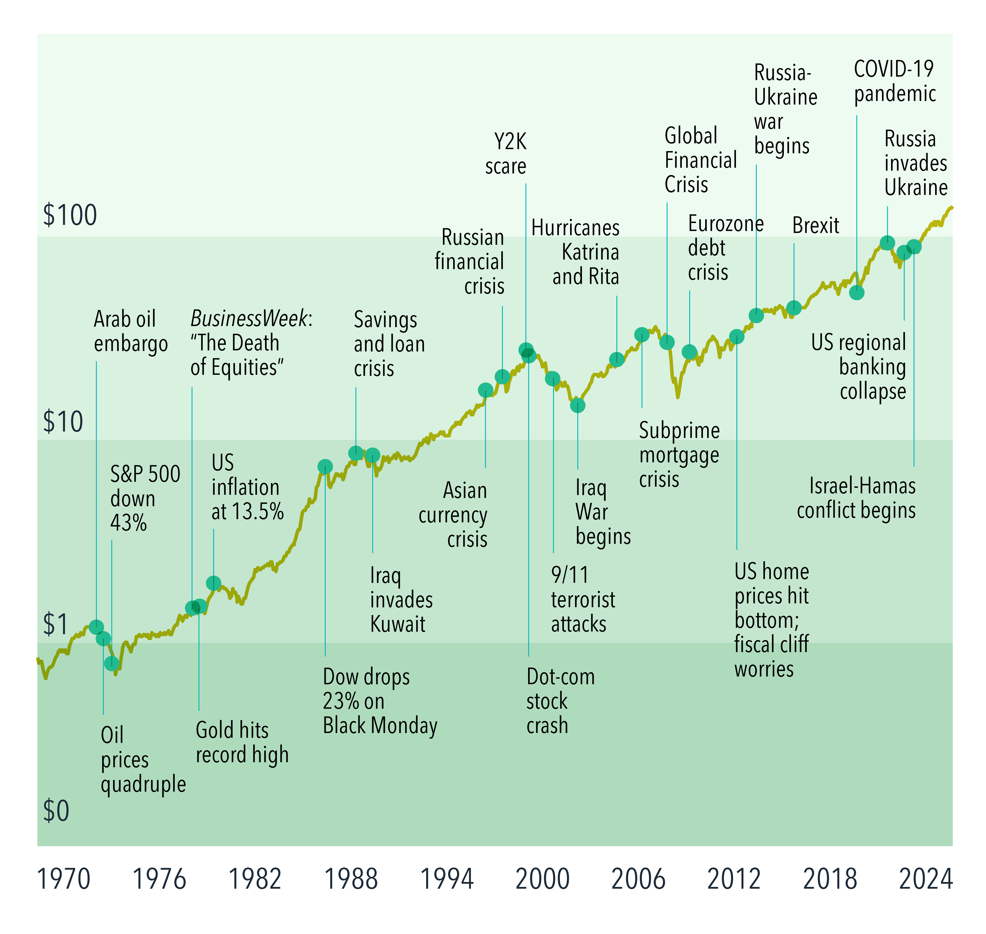
Geopolitical Risk
1st Quarter 2026
Wes Crill, PhD, Senior Client Solutions Director and Vice President, Dimensional Fund Advisors
Wars such as the one unfolding in Iran are always disturbing. For investors, there’s additional concern over whether these conflicts will spill over into their investment performance. But it’s important for investors to be cautious about making asset allocation changes in response to such events.
Markets are forward-looking. Prices move in response to changes in information. When unexpected developments arise that investors deem to be poor for markets, markets often drop. But the flip side is markets always set prices for positive expected returns. Once the news gets reflected in market prices, investors can still expect positive returns even amid worrisome circumstances.
This is borne out in historical stock returns. Global equity markets have continued an upward climb even in the face of economic and political upheavals. We don’t have to look far for illustrative examples. During the past few years, stock markets have had positive returns despite multiple wars being fought around the world.
This is not to trivialize the destruction wars bring and their impact on geopolitical risks. But history suggests investors may not help themselves by divesting from stocks. For long-term investors, the best bet is usually to stay the course.
MARKETS HAVE REWARDED DISCIPLINE
Growth of $1—MSCI World Index (net dividends), 1970–2025
135208

Slide 16
Geopolitical Risk
(continued from page 15)
Past performance is no guarantee of future results.
Glossary
Expected return: An estimate of average anticipated returns informed by historical data.
Disclosures
The information in this material is intended for the recipient’s background information and use only. It is provided in good faith and without any warranty or representation as to accuracy or completeness. Information and opinions presented in this material have been obtained or derived from sources believed by Dimensional to be reliable, and Dimensional has reasonable grounds to believe that all factual information herein is true as at the date of this material. It does not constitute investment advice, a recommendation, or an offer of any services or products for sale and is not intended to provide a sufficient basis on which to make an investment decision. Before acting on any information in this document, you should consider whether it is appropriate for your particular circumstances and, if appropriate, seek professional advice. It is the responsibility of any persons wishing to make a purchase to inform themselves of and observe all applicable laws and regulations. Unauthorized reproduction or transmission of this material is strictly prohibited. Dimensional accepts no responsibility for loss arising from the use of the information contained herein.
This material is not directed at any person in any jurisdiction where the availability of this material is prohibited or would subject Dimensional or its products or services to any registration, licensing, or other such legal requirements within the jurisdiction.
“Dimensional” refers to the Dimensional separate but affiliated entities generally, rather than to one particular entity. These entities are Dimensional Fund Advisors LP, Dimensional Fund Advisors Ltd., Dimensional Ireland Limited, DFA Australia Limited, Dimensional Fund Advisors Canada ULC, Dimensional Fund Advisors Pte. Ltd., Dimensional Japan Ltd., and Dimensional Hong Kong Limited.
RISKS
Investments involve risks. The investment return and principal value of an investment may fluctuate so that an investor’s shares, when redeemed, may be worth more or less than their original value. Past performance is not a guarantee of future results. There is no guarantee strategies will be successful.
Dimensional Fund Advisors LP is an investment advisor registered with the Securities and Exchange Commission.
Investment products: • Not FDIC Insured • Not Bank Guaranteed • May Lose Value
Dimensional Fund Advisors does not have any bank affiliates.
135209

